Slide 1
Streaming Data Applications
Pravin Y Pawar

Slide 2
Why is stream Processing needed?
Reason 1
Some data naturally comes as a never-ending stream of events. To do batch processing, you need to store it, stop data collection at some time and processes the data.
Then you have to do the next batch and then worry about aggregating across multiple batches.
In contrast, streaming handles never ending data streams gracefully and naturally.
You can detect patterns, inspect results, look at multiple levels of focus, and also easily look at data from multiple streams simultaneously.
Source : https://medium.com/stream-processing/what-is-stream-processing-1eadfca11b97

Slide 3
Why is stream Processing needed? (2)
Reason 2
Stream processing naturally fit with time series data and detecting patterns over time.
For example, if you are trying to detect the length of a web session in a never-ending stream ( this is an example of trying to detect a sequence).
It is very hard to do it with batches as some session will fall into two batches.
Stream processing can handle this easily.

Slide 4
Why is stream Processing needed? (3)
Reason 3
Batch processing lets the data build up and try to process them at once while stream processing process data as they come in hence spread the processing over time.
Hence stream processing can work with a lot less hardware than batch processing.
Furthermore, stream processing also enables approximate query processing via systematic load shedding.
Hence stream processing fits naturally into use cases where approximate answers are sufficient.

Slide 5
Why is stream Processing needed? (4)
Reason 4
Finally, there are a lot of streaming data available ( e.g. customer transactions, activities, website visits) and they will grow faster with IoT use cases ( all kind of sensors).
Streaming is a much more natural model to think about and program those use cases.

Slide 6
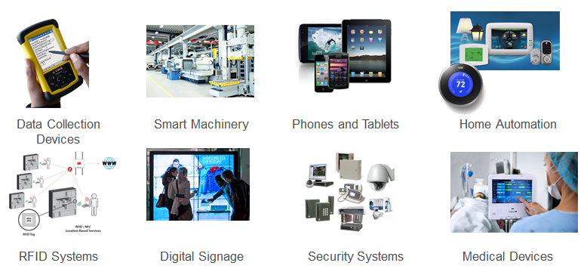
Streaming Data Sources
Source : https://mapr.com/blog/real-time-streaming-data-pipelines-apache-apis-kafka-spark-streaming-and-hbase/

Slide 7
Streaming Data Examples
Sensors in transportation vehicles, industrial equipment, and farm machinery send data to a streaming application. The application monitors performance, detects any potential defects in advance, and places a spare part order automatically preventing equipment down time.
A financial institution tracks changes in the stock market in real time, computes value-at-risk, and automatically rebalances portfolios based on stock price movements.
A real-estate website tracks a subset of data from consumers’ mobile devices and makes real-time property recommendations of properties to visit based on their geo-location.
A solar power company has to maintain power throughput for its customers, or pay penalties. It implemented a streaming data application that monitors of all of panels in the field, and schedules service in real time, thereby minimizing the periods of low throughput from each panel and the associated penalty payouts.
A media publisher streams billions of click stream records from its online properties, aggregates and enriches the data with demographic information about users, and optimizes content placement on its site, delivering relevancy and better experience to its audience.
An online gaming company collects streaming data about player-game interactions, and feeds the data into its gaming platform. It then analyzes the data in real-time, offers incentives and dynamic experiences to engage its players.
Source : https://aws.amazon.com/streaming-data/

Slide 8
Who is using Stream Processing?
Streaming Data Use cases
Algorithmic Trading, Stock Market Surveillance,
Smart Patient Care
Monitoring a production line
Supply chain optimizations
Intrusion, Surveillance and Fraud Detection
Most Smart Device Applications: Smart Car, Smart Home ..
Smart Grid — (e.g. load prediction and outlier plug detection see Smart grids, 4 Billion events, throughout in range of 100Ks)
Traffic Monitoring, Geofencing, Vehicle, and Wildlife tracking — e.g. TFL London Transport Management System
Sports analytics — Augment Sports with real-time analytics
Context-aware promotions and advertising
Computer system and network monitoring
Predictive Maintenance, (e.g. Machine Learning Techniques for Predictive Maintenance)
Geospatial data processing
Source : https://medium.com/stream-processing/what-is-stream-processing-1eadfca11b97

Slide 9
Thank You!
In our next session: Sources of Streaming Data

